Slide 1

Excel Final Assessment - Batch -4
Jagadeesh Misenam
4283

Slide 2
Q3

Slide 3
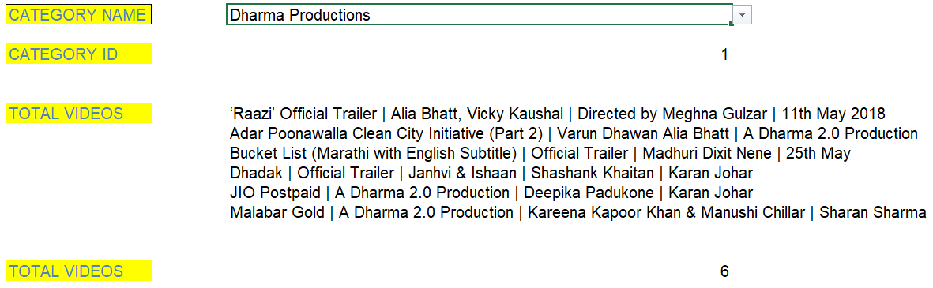
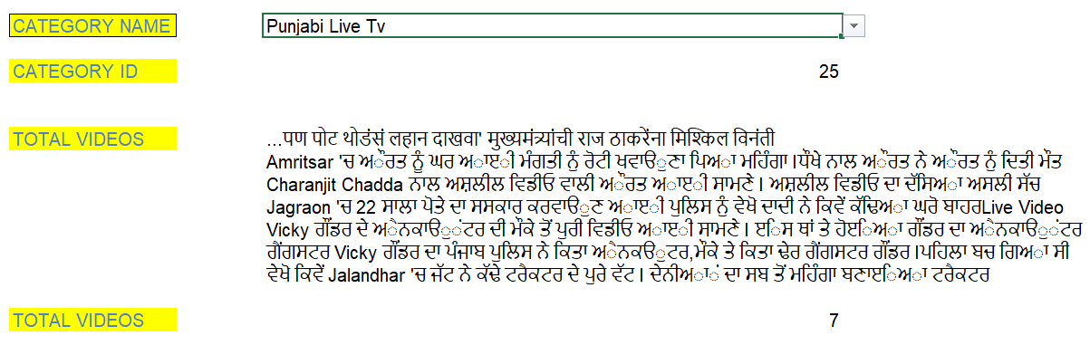
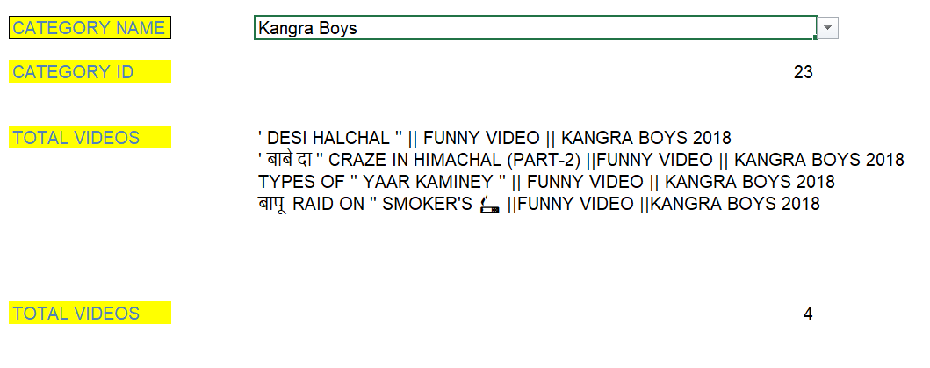
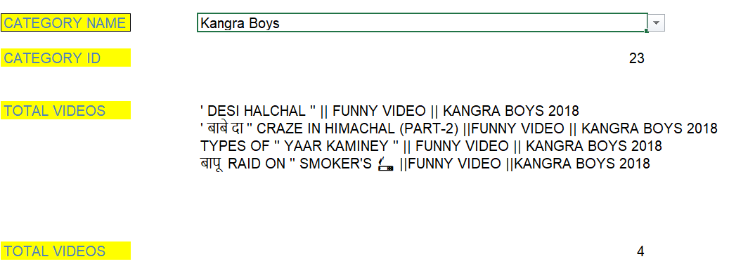
Q4
COUNTA(FILTER('YouTube data'!C:C,'YouTube data'!D:D=Sheet4!D4))
FILTER('YouTube data'!C:C,'YouTube data'!D:D=Sheet4!D4)

Slide 4
Q15)a
1 NO OF LIKES
1 NO OF DISLIKES
Insights: No of likes are
More comparative to the
dislikes

Slide 5
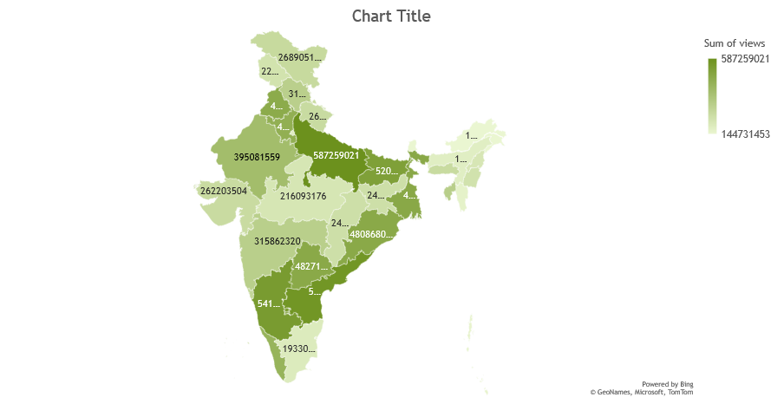
Q16)
UP Has the highest
Sum of views of
587259021

Slide 6
Q17)
Insights: Category_id 10 has the
Highest sum of views and 17 has
The least sum of views
Sum of likes and sum of dislikes are negligible compared to the sum of views

Slide 7
Q18)
Pehchan Music has
The highest sum of
likes

Slide 8
Q19)

Slide 9
Q20
VIEWS OVER TIME

Slide 10
Q14
PERFORMANCE V CATEGORIES
Category_id 24
Has the highest
Performance over
38%

Slide 11
Q13

Slide 12
Q8

Slide 13
Q7

Slide 14
Q1 – Q5 DONE IN THE EXCEL SHEET
Thank YOU

